Slide 1
EFR32 Layout Design Practices
2.4 GHz specific part
Notes:
1
Hi, I am an RF applications engineer at Silicon Labs and I am going to demonstrate a few RF layout design practices which should be applied during the construction of an ISM band unit.
The design tricks mentioned in this video and in our layout design guides, application notes should be carefully followed in order to achieve the best RF performance.
This video can be divided into 3 big parts. In the first section I am going to speak about the importance of proper RF layout design. The main part of the video is going to show the most important RF layout design practices by providing both an incorrect and a correct design highlighting the presented design practice. In the last section I am going to show a layout design where the presented recommendations seem to be more or less implemented but still there will be some minor mistakes in the design.

Slide 2
Importance of Proper RF Layout Design
Improper design causes performance degradation
Shorter communication distance (weaker link budget)
Violation of EMC regulation (higher harmonics, spurs)
Shorter battery life
The overall RF performance can be affected by
Layout of the RF section
position/distance/orientation of RF components
routing and dimensions of RF traces
antenna
Layout of the entire PCB
ground metallization
routing of non-RF traces (especially the supply lines)
substrate parameters (thickness, dielectric constant, number of metal layers)
Filtering & isolating the extra possible noise sources
High speed clocks, oscillators, processors, memory blocks
DC/DC converters
Positions and values of the supply bypass capacitors
Notes:
First, we should discuss why the proper layout design is important for these units.
It is important since it affects the RF performance of the unit. If the layout is designed incorrectly that can cause degradation in the communication distance, the unit can violate the relevant EMC regulation and even the battery life can be reduced.
At first, one would think that the RF performance is affected by only the layout of the RF section: the position, distance and orientation of the RF components in the matching network, the routing and dimensions of the RF traces and of course, the used antenna.
But beside these there are a few additional factors, such as: ground metallization, the routing of non-RF traces, especially the supply lines, and even the substrate parameters: board thickness, dielectric constant and the number of layers.
Furthermore, the other high speed blocks and converters mounted on the board can cause extra spurs in the RF spectrum or sensitivity degradation. So, the filtering and the isolation away of these blocks from the RF part become also important.

Slide 3
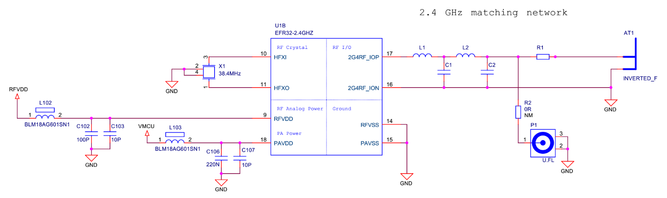
RF circuit functions
RF circuit functions:
TX:
Deliver the required TX RF power
Impedance transformation
Harmonic/spur suppression
RX:
Impedance match
Notes:
The most important part of the proper layo
The RF transmitter ICs can synthetize high frequency and high power signals at their TX output: fundamental, its harmonics and additional spurious content. A part of this power is radiated; the other part is dissipated on losses.
On the Silicon Labs’ reference design boards the function of the TX matching is to drive most of the fundamental power into the antenna, thus to provide the required impedance transformation between the RFIC and the load. Simultaneously for suppressing harmonics and spurs, a proper filtering network should be used between the matching network and the antennat design is the RF circuitry itself.
. The matching and filtering is combined in one series-L parallel-C ladder structured network which is also used for the RX side during receive mode.
Examples shown in this video are based on a general 2.4 GHz EFR32 Radio Board. The main layout design concepts are shown with this reference layout to demonstrate the basic principles. Although these rules will be shown through a design that uses a 4-element matching, similar design practices should be applied with a 2-element matching network as well. For low power applications (below 13 dBm) a 2-element L-C network is sufficient, while high power solutions (above 13 dBm) require a 4-element match.

Slide 4
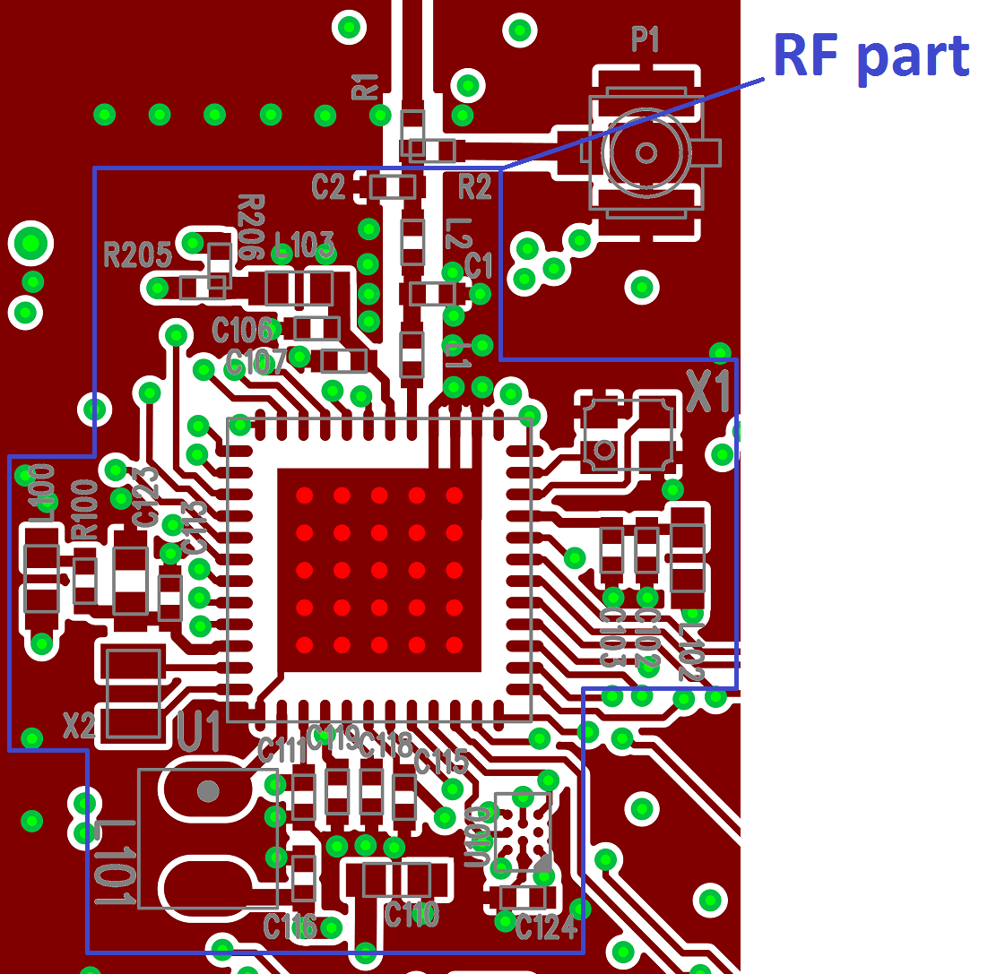
Layout of the RF section
Custom designs
Copy reference design ’as is’, if possible
Deviations cause detuning:
Component distance (trace lengths) → Series parasitic inductances
Substrate parameters, pad size, gaps between traces → Parallel parasitic capacitances
Component distance/orientation → Couplings
Component type/size → Component parasitics
Detuning cause problems:
Decreased TX power/RX sensitivity
Increased spurious emission levels
Increased current consumption
Frequency offset
These can be observed with conducted and radiated measurements too.
Recommended to copy the RF section of Silicon Labs’ reference design ‘as is’
Notes:
The reference schematics and layout designs of the matching networks are usually provided by the manufacturer of the RFIC. It is recommended to copy the entire RF area from a reference design as is. Of course it is not always possible due to size restrictions, different form factors etc., thus, a custom design may need to deviate from the reference one.
Although the size of a matching network is relatively small, due to the high frequency the matching is sensitive to the physical parameters of the matching layout (beside the component values, of course). Compared to a reference layout design:
- Different component distances and trace lengths introduce different parasitic inductances
- Different substrate thickness, dielectric constant and gaps between traces introduce different parasitic capacitances
- Different component distance/orientation/relative orientation introduce different coupling between components
- Different component types/sizes introduce different component parasitics
These can cause detuning of the reference matching or filtering and/or detuning of the load of the RF crystal. The possible effects can be:
- Decreased TX output power of the fundamental
- Decreased RX sensitivity
- Increased spurious emission levels
- Increased current consumption
- Frequency offset between different boards
All these mentioned effects can be observed both with conducted and radiated measurements.

Slide 5
Layout of the entire PCB
Whole board is a radiating system → non-RF sections also affect the radiated performance!
Ground plane structure and size affect
Power of the fundamental (ground plane for monopole-type antennas)
Level of radiated spurs (shielding, filtering, hidden patch antennas)
Non-RF traces affect
Level of radiated spurs (coupling → form hidden antennas)
With incorrect design it is possible to have
Conducted performance OK
Fundamental power as specified
Spurs below EMC limits with margin
Antenna OK
Tuned to the proper frequency
Provides suppression for spurs
But, the radiated performance: FAIL
Not OK, as it would be expected from the conducted results
Notes:
From RF radiation point of view the whole PCB should be considered as a system. So not only the design of the RF area but in most cases the layout of the entire PCB can affect the radiated performance.
Practically, in case of an incorrect RF module layout design the radiated spectrum can have lower fundamental and higher harmonics or spurs compared to the values expected based on the conducted output spectrum and the gain of the used antenna. Incorrect layout can cause the radiated spurs to violate the relevant EMC regulation even if in the conducted spectrum they are below the limit with nice margins.
Although in most cases the reference designs are not complete applications, the RF layout design principles introduced on them should be applied for the whole PCB area containing the RF section or module.
If copying the reference layout design is not possible, the layout design recommendations shown in the next slides should be applied.

Slide 6
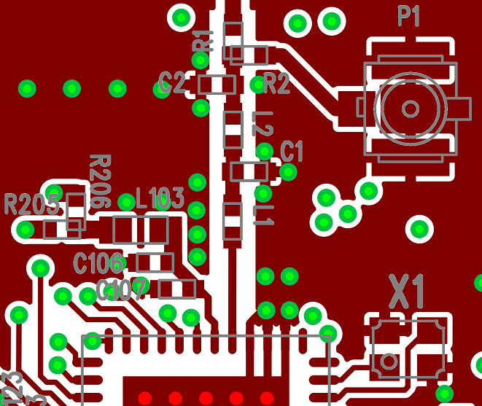
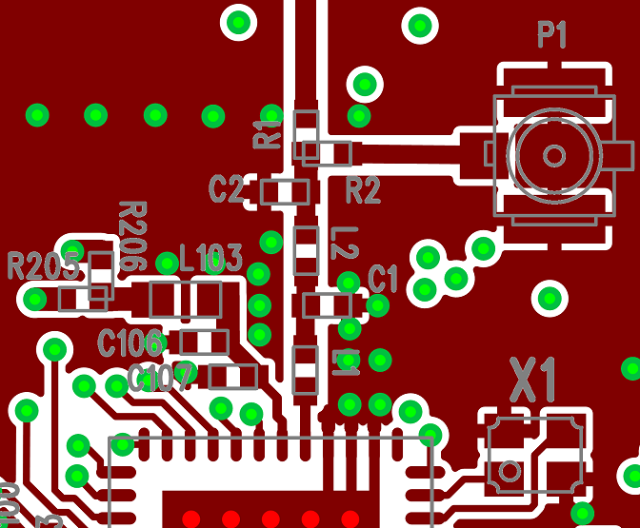
Layout Design Practices – RF Section
Minimize distance between neighboring components
Matching network components should be close to each other and to the RF IC
For nearby components use the width of the pads for trace width
Incorrect design Correct design
Notes:
The first component of the matching network should be placed as close to the 2G4RF_IOP pin of the RF IC as possible to reduce the series parasitic inductance and to avoid any detuning effects.

Slide 7
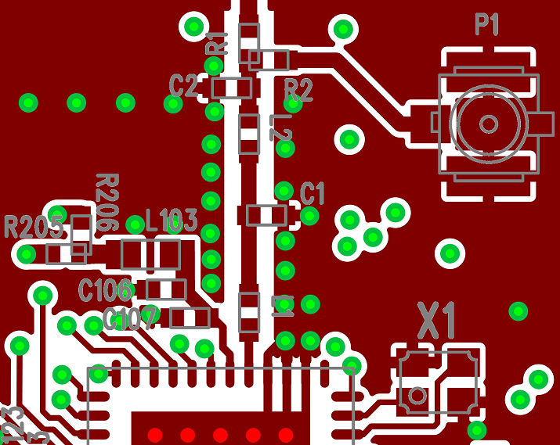
Layout Design Practices – RF Section
Minimize distance between neighboring components
Matching network components should be close to each other and to the RF IC
For nearby components use the width of the pads for trace width
Incorrect design Correct design
Notes:
The neighboring matching network components should be placed as close to each other as possible to minimize any PCB parasitic capacitance to the ground and the series parasitic inductances between the components.
Use the same (or near the same) trace width for connecting the components to each other as the pad width, it is typically 20 mil in case of using 0402 sized SMD components. The widened connections are necessary to reduce series parasitic inductance between components.

Slide 8
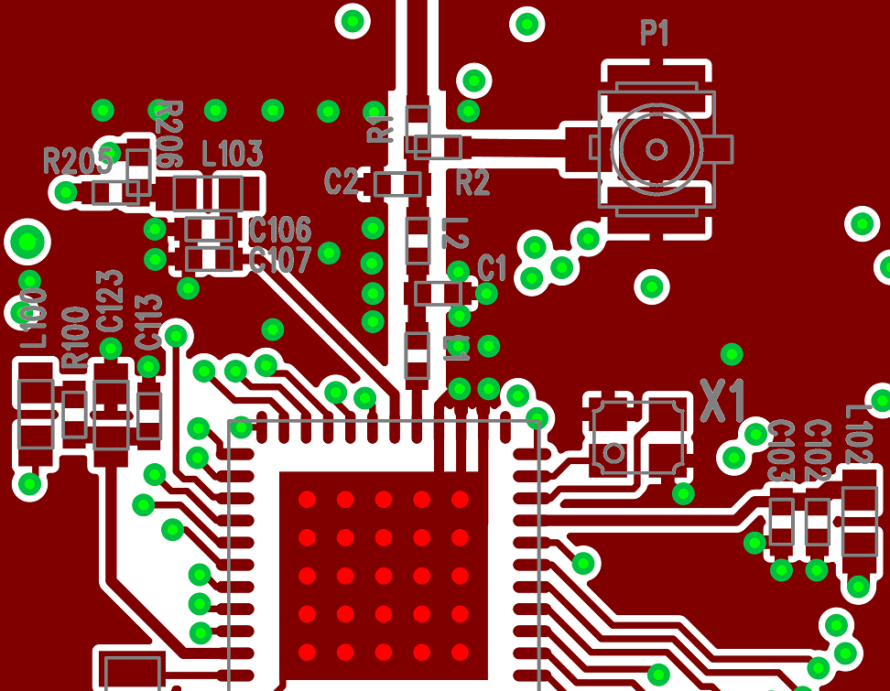
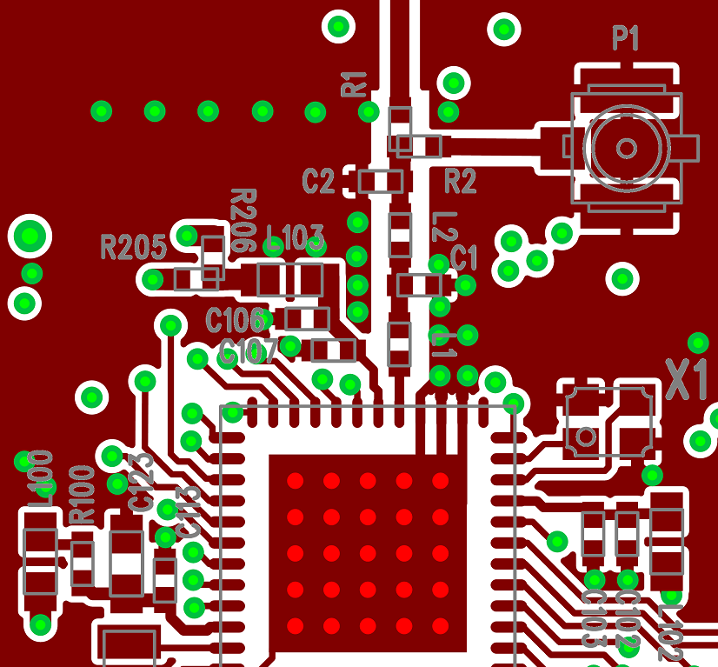
Layout Design Practices – RF Section
Minimize distance between neighboring components
VDD filter capacitors should be placed close to the VDD pin (smallest value one should be the closest)
Incorrect design Correct design
Notes:
The lowest value bypass capacitors filter on frequencies around the fundamental, this way they have to be placed close to the VDD pins and need good grounding (with many close vias) at the ground side. The capacitor with the value around 100nF filters the several tenths of MHz frequency range, thus the leaking clock spurs. Filtering these spurs is important as they can be upconverted inside the chip causing unwanted spurs at several 10MHz offset around the carrier. The largest value capacitor filters the several hundred kHz interferences typically coming from a switching power supply. It can be placed far away from the VDD pins and is not required in case of battery operation.
VDD filtering capacitors should be placed close to the VDD pins (the smallest value one should be the closest).

Slide 9
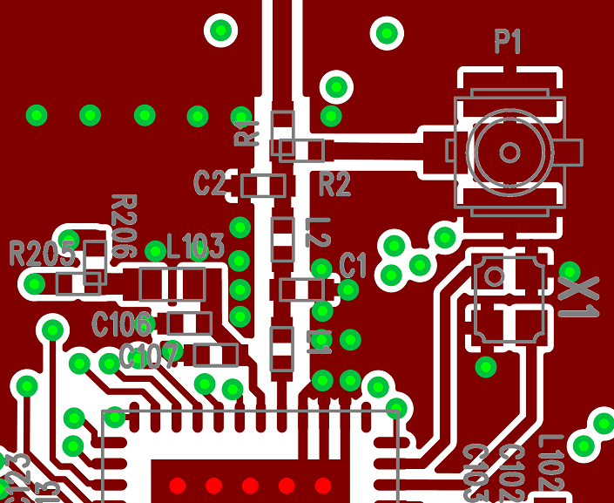
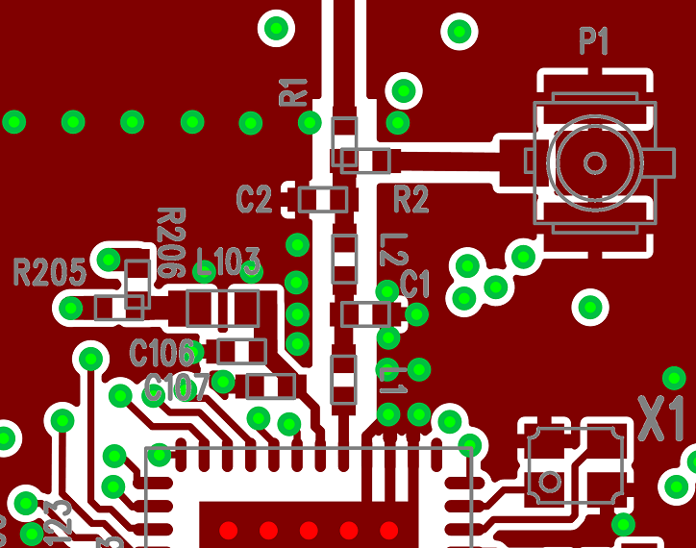
Layout Design Practices – RF Section
Place the crystal close to the RF IC
Incorrect design Correct design
Notes:
The crystal should be placed as close to the RFIC as possible to ensure that wire parasitic capacitances are kept as low as possible; this will reduce any frequency offsets. Avoid leading supply traces close or beneath the crystal or parallel with a crystal signal or clock trace. Use similar topology for all boards in the communication system.

Slide 10
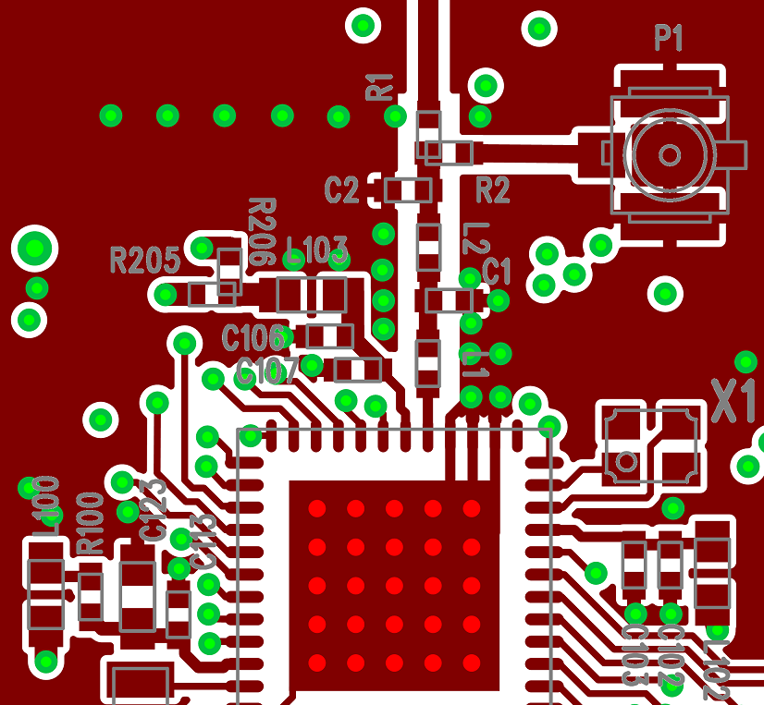
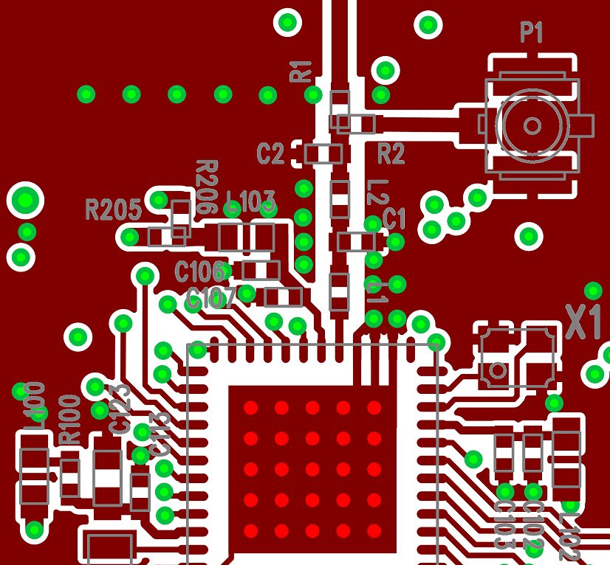
Layout Design Practices – RF Section
Connect the crystal case to the ground
Incorrect design Correct design
Notes:
Connect the crystal case to the ground using many vias to avoid radiation of the ungrounded parts. Do not leave any metal unconnected and floating that may be an unwanted radiator.

Slide 11
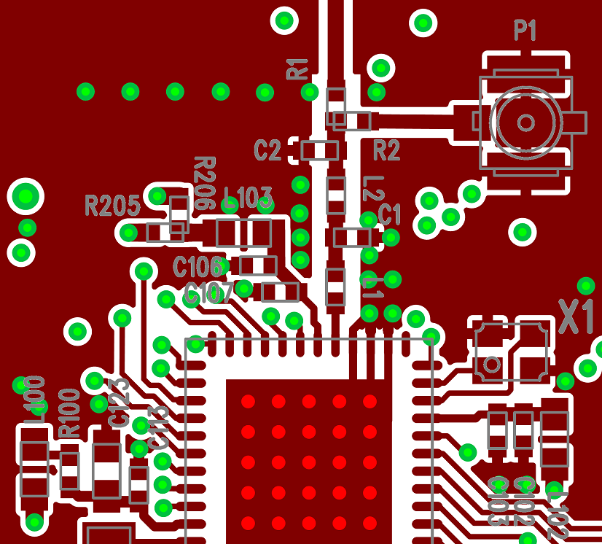
Layout Design Practices – RF Section
Use an isolating ground metal between the crystal and VDD traces
Incorrect design Correct design
Notes:
Use an isolating ground metal between the crystal and VDD traces to avoid any detuning effects on the crystal caused by the nearby power supply and to avoid the leakage of the crystal or clock signal and its harmonics to the supply lines.

Slide 12
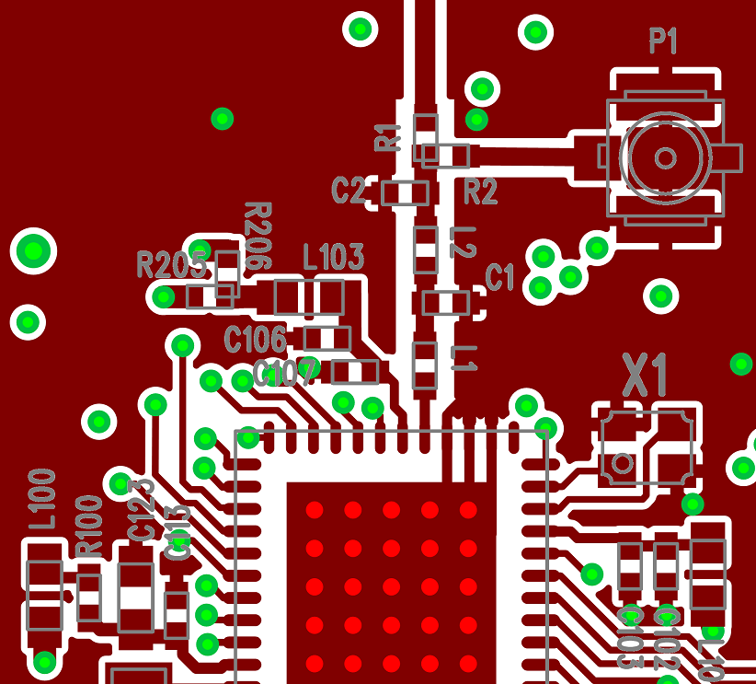
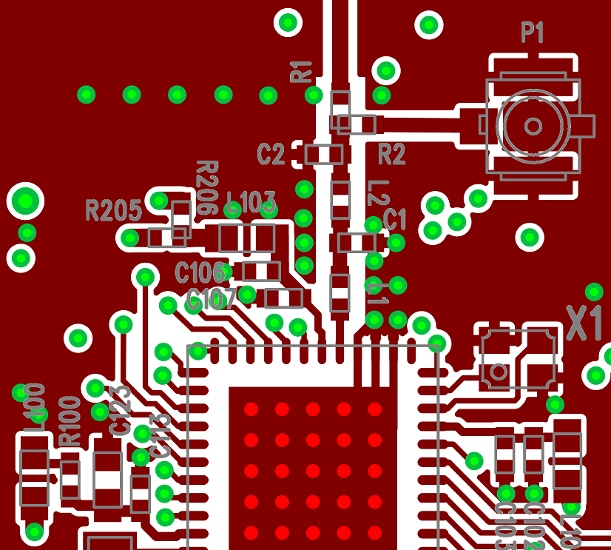
Layout Design Practices – RF Section
Provide good RF grounding for GND pads
Parallel capacitors
RF IC exposed pad
Incorrect design Correct design
Notes:
The grounding effect in the thermal straps used with capacitors should be improved. In addition, the trace near the GND pin of these capacitors should be thickened, this will minimize series parasitic inductance between the ground pour and the GND pins. Additional vias placed close to the GND pin of capacitors (thus connecting it to the bottom or inner layer GND plane) will further help reduce these effects.
The reason for not using vias on the entire GND section is due to the restrictions of the actual radio board design. These restrictions include traces routed on other layers or components on the bottom side, which are not shown in this slide. The exposed pad footprint for the paddle of the EFR32 IC should use as many vias as possible to ensure good grounding and heat sink capability. In the reference designs there are 25 vias for the 7x7 mm sized package ICs, each with 10 mil diameter. The paddle ground should also be connected to the top layer GND metal, if possible, to further improve RF grounding; this may be accomplished with diagonal trace connections through the corners of the EFR32 IC footprint.

Slide 13
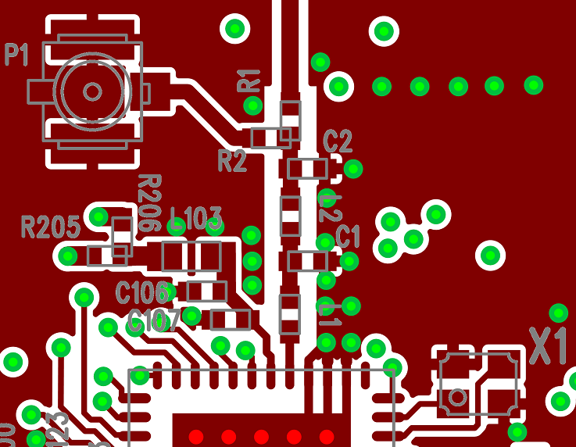
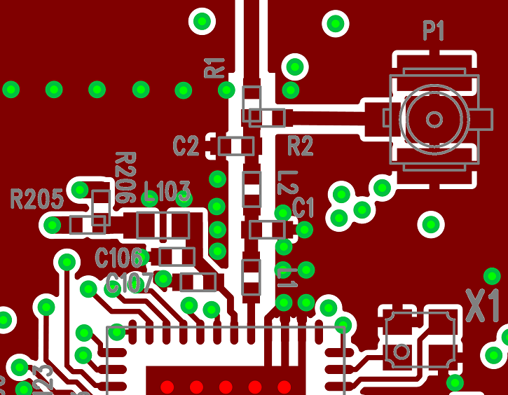
Layout Design Practices – RF Section
Connect the ground pins of the nearby filtering capacitors to ground planes on different sides of the transmission line
Incorrect design Correct design
Notes:
Couplings through the ground can occur between the nearby filtering capacitors (especially at high harmonics), which can decrease the effectiveness of the low-pass filtering and can cause higher harmonics that can be observed both conducted and radiated. To avoid the possible high harmanic levels, it is recommended to connect the nearby filtering capacitors to ground planes on different sides of the transmission line.

Slide 14
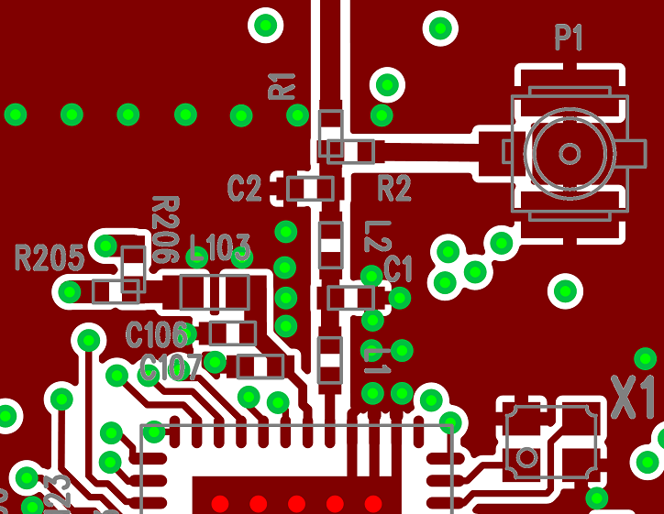

Layout Design Practices – RF Section
Have >=0.5mm separation between traces/pads and GND metal
Incorrect design Correct design
Notes:
Use at least 0.5 mm separation between traces/pads to the adjacent GND pours in the area of the matching network. This technique will minimize the parasitic capacitance and reduce the detuning effects.

Slide 15
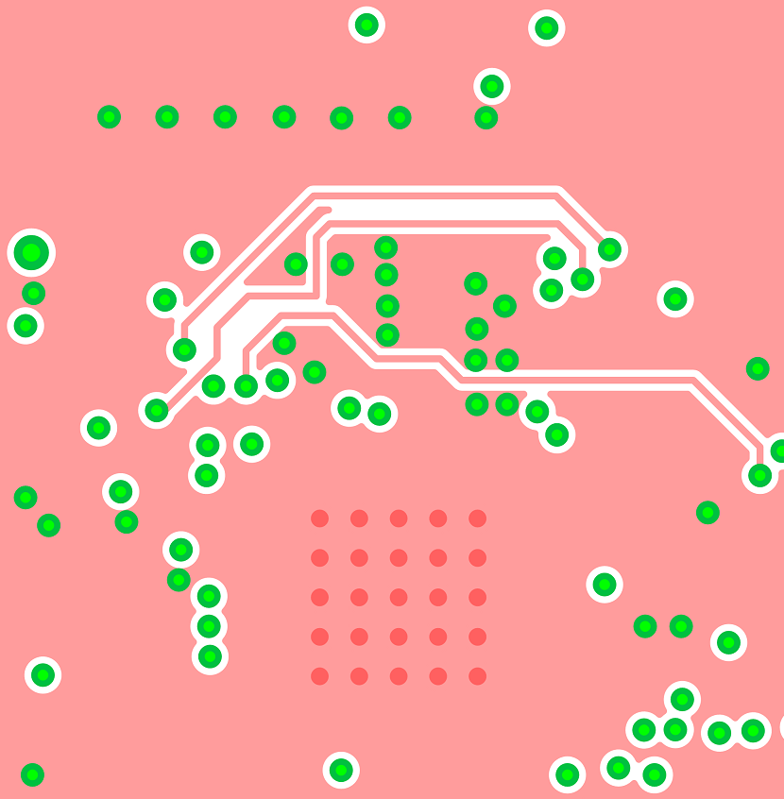
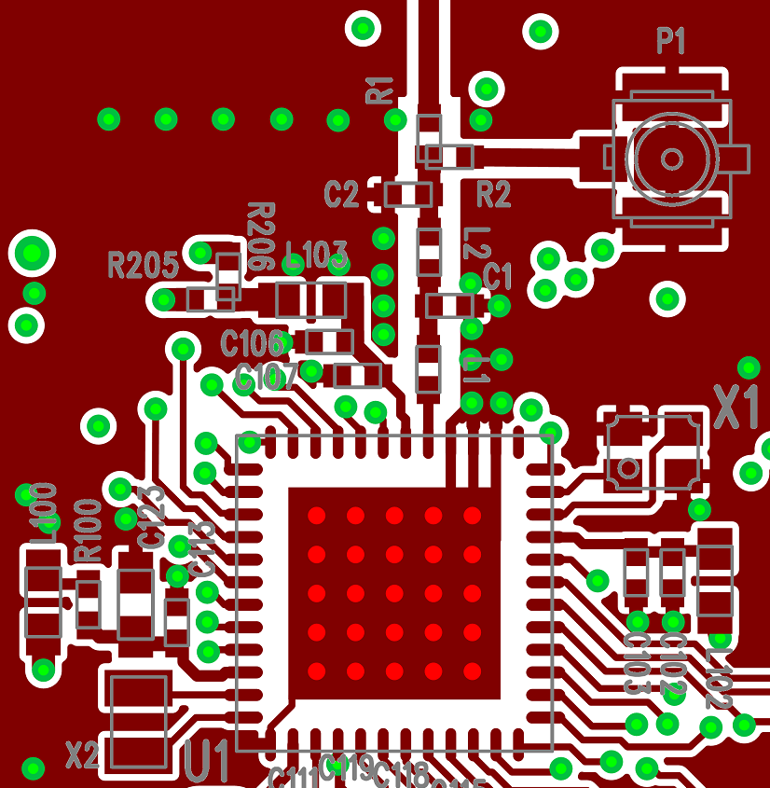

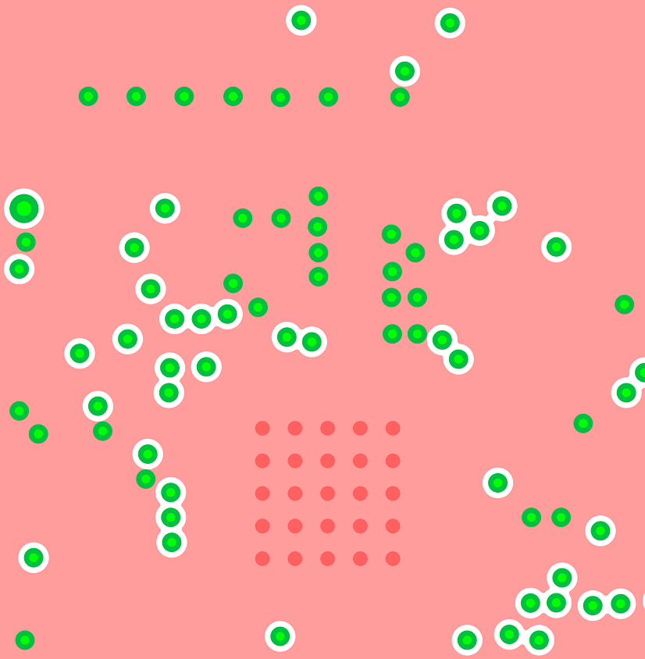
Layout Design Practices – RF Section
Fill the area beneath the matching network with continuous GND
Incorrect design Correct design
Notes:
The area under the RF chip and the matching network (in 4-layer PCBs, this is the first inner layer beneath the top layer) should be filled with continuous ground metal as it will show good ground reference for the matching network and will ensure a good, low impedance return path to the RF chip’s ground as well. Board routing and wiring should not be placed in this region to prevent coupling effects with the matching network. It is also recommended that the GND return path between the GND vias of the TX/RX matching network and the GND vias of the RFIC paddle should not be blocked in any way; the return currents should see a clear, unhindered pathway through the GND plane to the back of the RFIC.

Slide 16
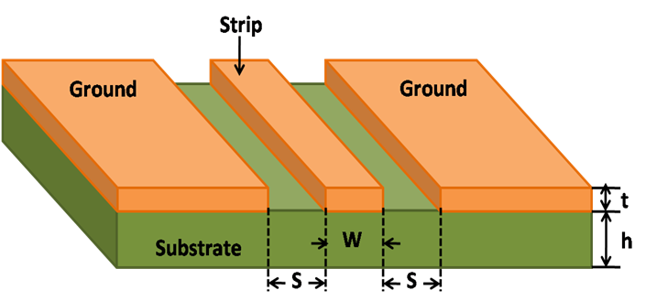
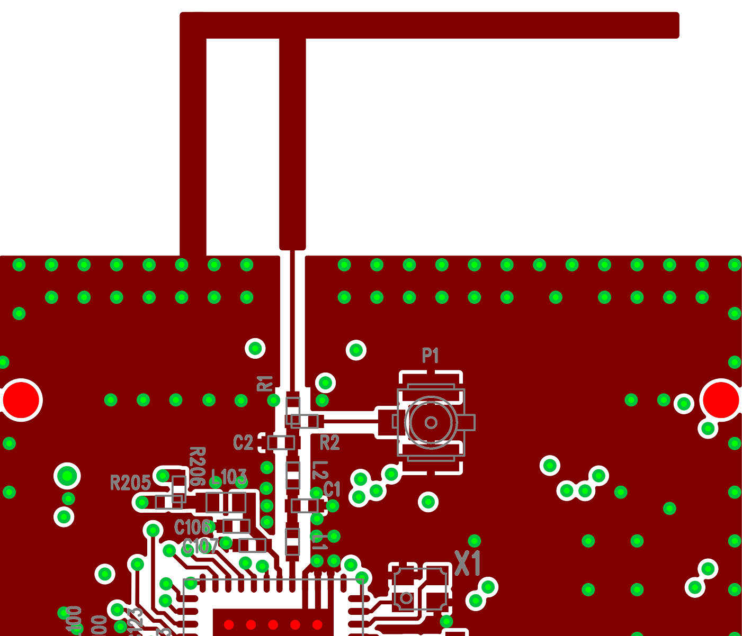

Layout Design Practices – RF Section
Use 50 Ohm grounded coplanar transmission lines to connect distant RF components
Online impedance calculators can be used to get the necessary trace width
Incorrect design Correct design
Notes:
Use 50 Ω grounded coplanar lines where possible for connecting the antenna or the U.FL connector to the matching to reduce sensitivity to PCB thickness variation. This will also reduce radiation and coupling effects. Use many GND vias near the coplanar lines in order to further reduce radiation.

Slide 17
Layout Design Practices – Entire PCB
Have large, continuous ground metal plane
Reduce fragmentation due to traces
Fill gaps with GND metal
Use many vias to connect the GND sections on different layers
Have larger via density at GND metal edges
PCB cutting edge
Around supply and transmission lines
Notes:
To achieve good RF ground on the layout, it is recommended to add large, continuous GND metallization around the area of the RF section (at a minimum). Better performance may be obtained if this is applied to the entire PCB. To provide a good RF ground, the RF voltage potentials should be equal along the entire GND area as this helps maintain good VDD filtering and also provides a good ground plane for the monopole-type antennas. Gaps should ideally be filled with GND metal and the resulting sections on the top and bottom layers should be connected with as many vias as possible.

Slide 18
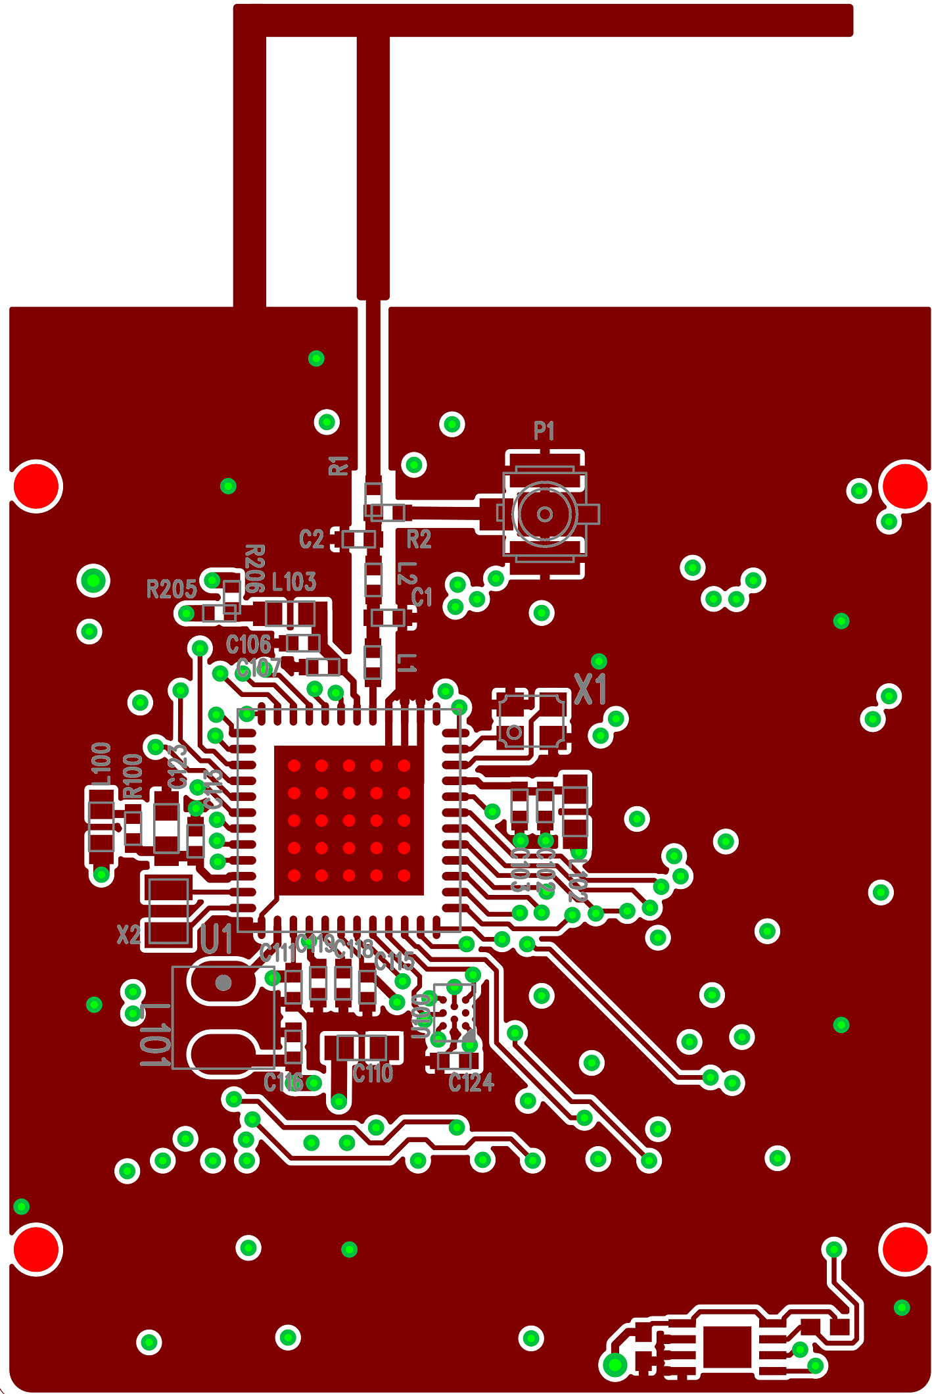
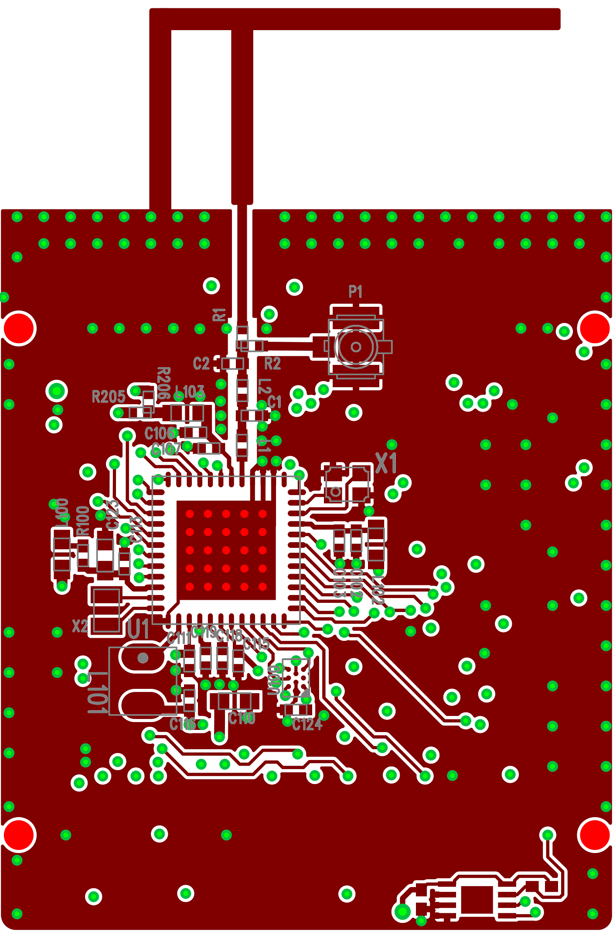
Layout Design Practices – Entire PCB
Have large, continuous ground metal plane
Incorrect design Correct design
Notes:
Use as many grounding vias at the GND metal edges (especially at the edge of the PCB and along the VDD traces) as possible in order to reduce their harmonic radiation caused by the fringing field.

Slide 19
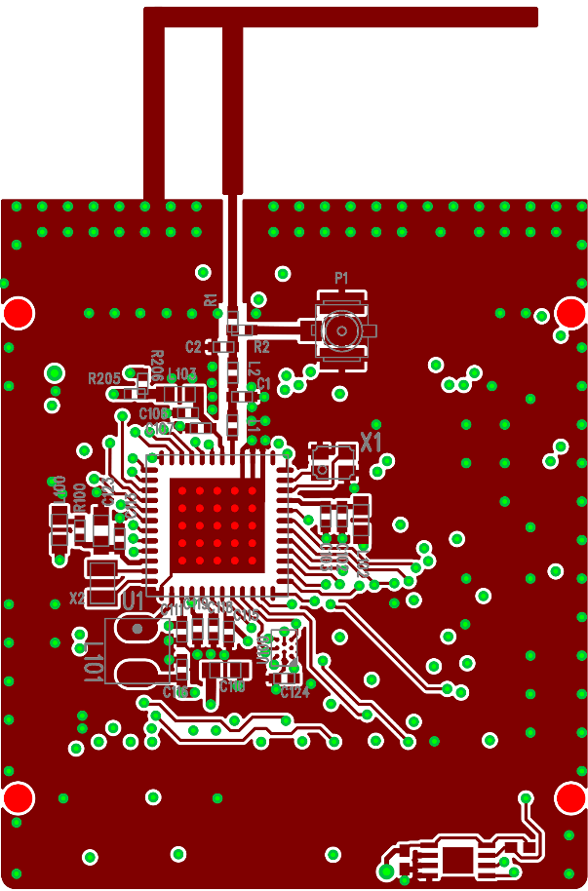
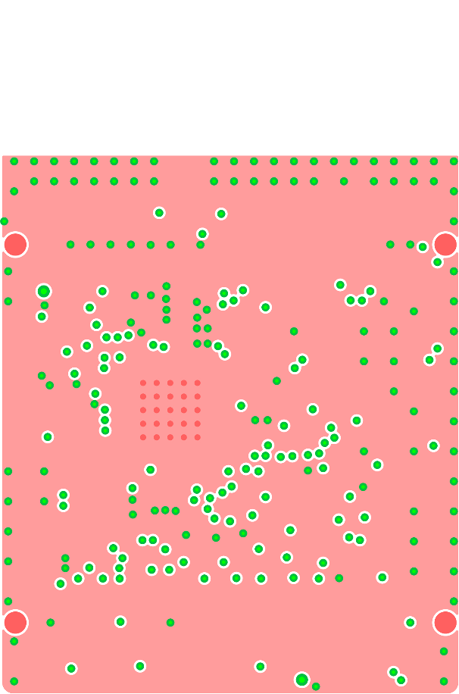
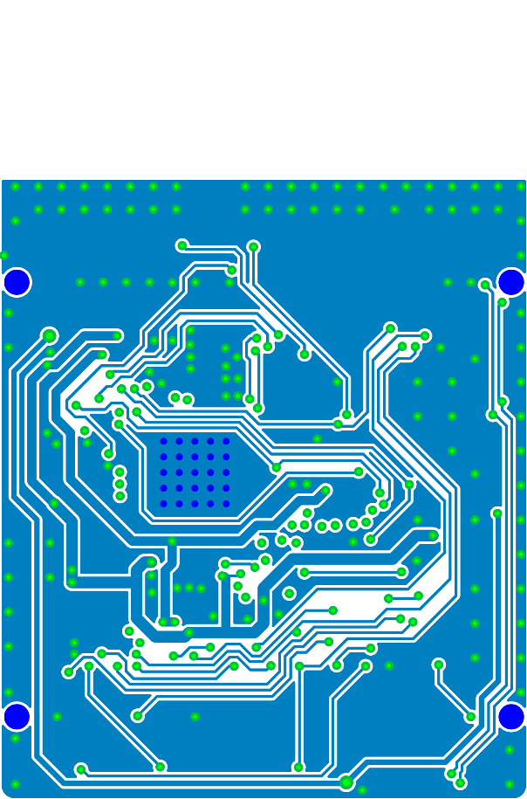
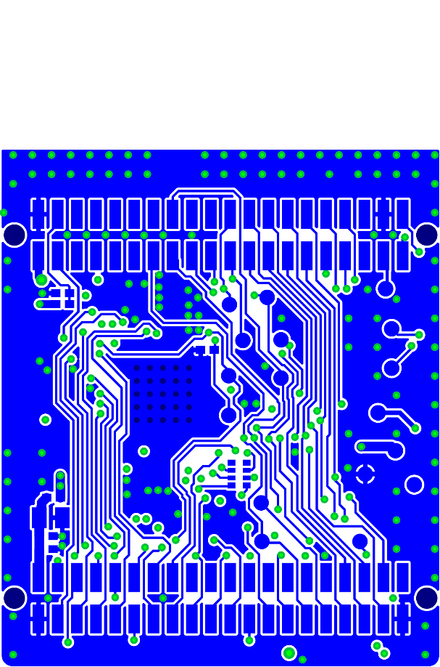
Layout Design Practices – Entire PCB
Route traces on inner layers (for boards with more than two layers)
Especially the supply lines
Avoid placing them close to the PCB edge
Ensure continuous solid GND metallization on the top and bottom layers
Top layer
1st Inner layer
2nd Inner layer
Bottom layer
Notes:
In a design with more than two layers, all of the wires/traces should be placed in one of the inner layers, especially the VDD trace. Also avoid putting it close to the edge of the PCB. The whole top and bottom layers should contain as much continuous GND metallization as possible in order to reduce the traces' radiations.

Slide 20
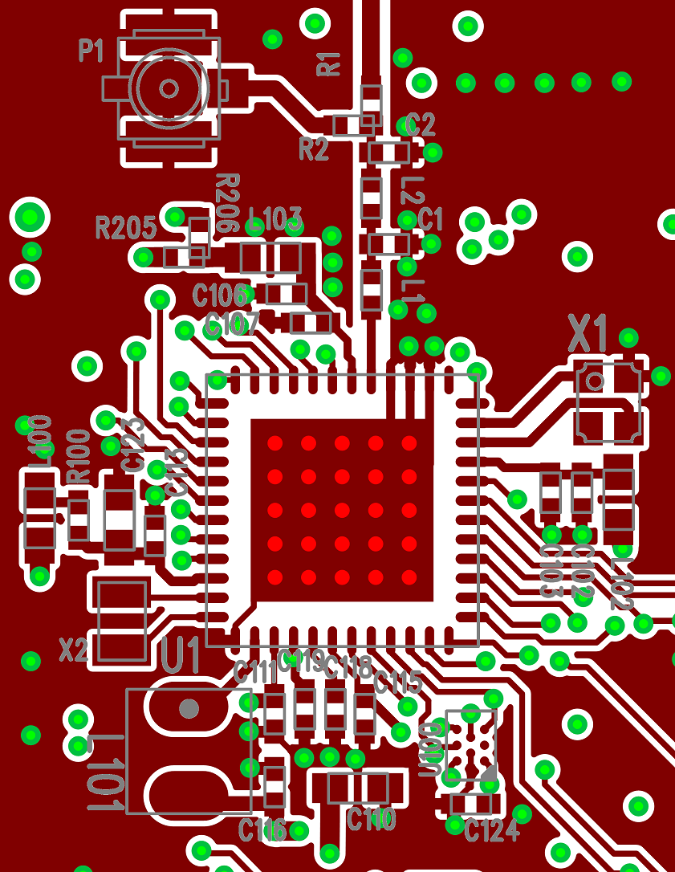
Example of an almost properly designed RF layout
Example of an almost properly designed RF layout
Notes:
In the last section I am going to show a layout where the previous recommendations seem to be more or less implemented but still there are some minor mistakes in the design. Those can cause detuning of the fundamental frequency, lower power level, higher current consumption and higher harmonic power level as well. The problems with this design will be showed step by step.

Slide 21
Example of an almost properly designed RF layout
Problems with the RF layout
First matching component after the 2G4RF_IOP pin (L1) is not as close to the RF IC as possible
Notes:
First of all, the first matching component (L1) should be placed as close to the 2G4RF_IOP pin as possible in order to reduce the series parasitic inductance which can detune the output impedance from the optimal 50 ohm.

Slide 22
Example of an almost properly designed RF layout
Problems with the RF layout
Crystal is not as close to the RF IC as possible
Notes:
The crystal should be placed as close to the RF IC as possible to ensure that wire parasitic capacitances are kept as low as possible; this will reduce any frequency offsets.

Slide 23
Example of an almost properly designed RF layout
Problems with the RF layout
Trace width is not the same as component width
Notes:
Use the same or near the same width traces for connecting the components to each other as the component width, it is typically 20 mil in case of using SMD0402 components.

Slide 24
Example of an almost properly designed RF layout
Problems with the RF layout
The second filtering capacitor (C2) is connected to the same ground plane as the first capacitor
Notes:
Connect the first (C1) and second (C2) filtering capacitor to ground planes on different sides of the transmission line to avoid the possible high frequency harmonic leakage through the ground plane.

Slide 25
Example of an almost properly designed RF layout
Problems with the RF layout
Missing via at the ground pin of the PA VDD filtering capacitor
Notes:
The ground pin of the pF valued PAVDD filtering capacitor does not have any GND via, this way it is connected to an isolated metal with no ground connection.

Slide 26
Example of an almost properly designed RF layout
Problems with the RF layout
No isolating ground metal exists between the crystal and the RFVDD trace
Notes:
Use an isolating ground metal between the crystal and VDD traces to avoid any detuning effects on the crystal caused by the nearby power supply and to avoid the leakage of the crystal or clock signal and its harmonics to the supply lines.

Slide 27
Example of an almost properly designed RF layout
Problems with the RF layout
There is not enough separation between traces/pads and GND metal around the matching network
Notes:
Use at least 0.5 mm separation between traces/pads to the adjacent GND pours in the area of the matching network in order to minimize the parasitic capacitance and reduce the detuning effects.

Slide 28

Layout Design Practices – Additional Notes I.
Check the data sheet of the used part for design recommendations
Associated collaterals:
AN928: EFR32 Layout Design Guide
Notes:
Check the data sheet of the used part for design recommendations. Further details on proper RF layout design can be found in AN928: EFR32 Layout Design Guide Application Note.

Slide 29
Thank You!
www.silabs.com
Notes:
29
Thank you for watching!

